Slide 1
CSE 202 - Discrete Mathematics II

Slide 2
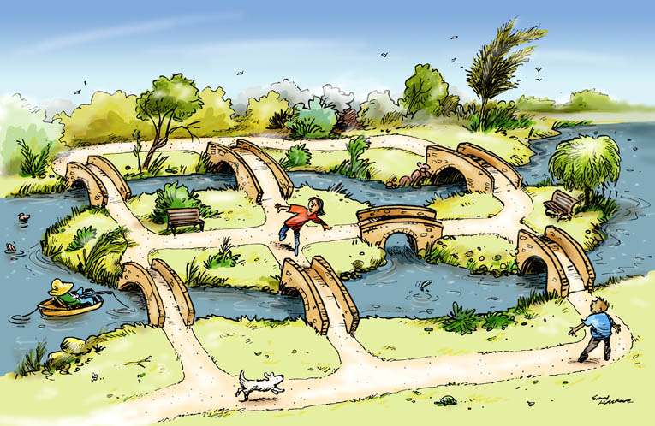
Seven Bridges of Königsberg

Slide 3
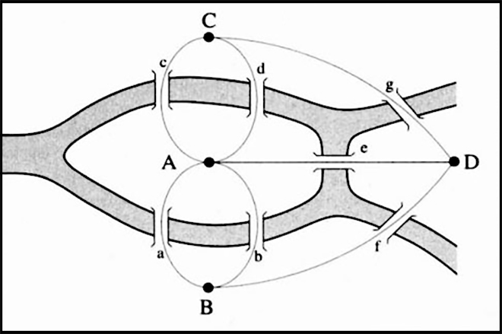
Seven Bridges of Königsberg

Slide 4
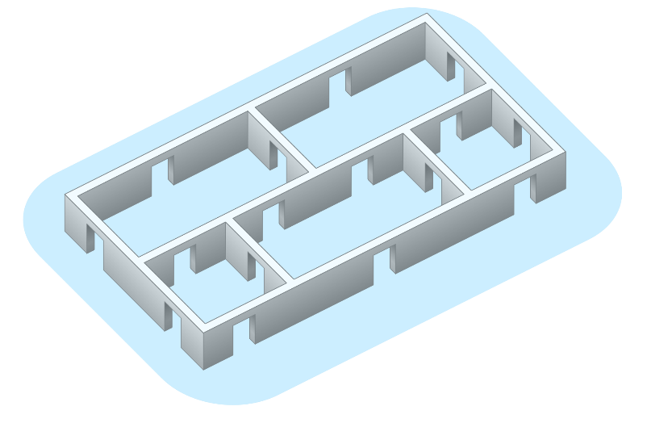
Is it possible to go through all the doors provided that each door is passed through only once?

Slide 5
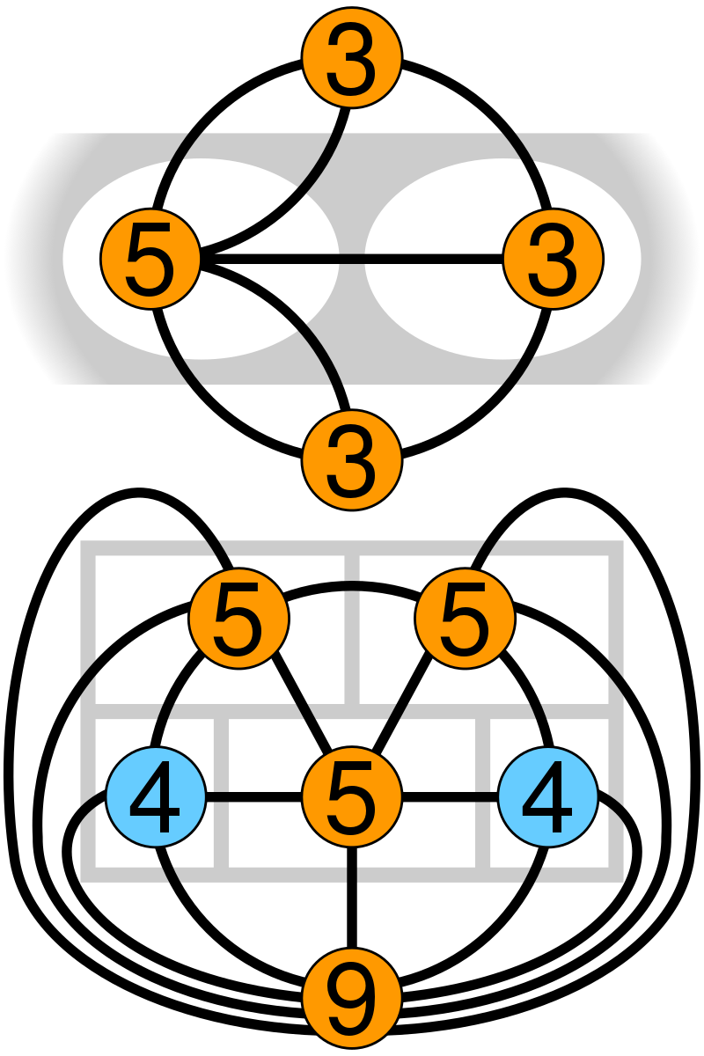

Slide 6
Definition
A graph is an ordered triple G=(V, E,ϕ)
V, a set of vertices (also called nodes or points);
E, a set of edges (also called links or lines);
ϕ: E →{{x, y} ∣ x,y ∈V} an incidence function mapping every edge to a pair of vertices

Slide 7
Graph theory
The basic idea of graphs were first introduced in the 18th century (1735) by Swiss mathematician Leonhard Euler on “Seven Bridges of Königsberg”
In Mathematics, it is a sub-field that deals with the study of graphs. Graph theory is the study of relationship between the vertices (nodes) and edges (lines).

Slide 8
Why Study Graph Theory?
1. A Powerful Modeling Tool
Graphs represent relationships and structures: social networks, computer networks, circuits, molecules, the web, etc.
2. Foundation of Key Algorithms
BFS, DFS, Dijkstra, Bellman-Ford, Kruskal, SCC, etc.
Useful for pathfinding, optimization, scheduling, and network analysis.

Slide 9
Why Study Graph Theory?
3. Broad Real-World Applications
- 🚗 GPS and navigation systems
- 🌐 Search engines and recommendation systems
- 🧬 Bioinformatics (e.g., protein or gene networks)
- 🔐 Cybersecurity and fraud detection
- 🧠 Artificial Intelligence and Graph Neural Networks (GNNs)
4. Enhances Logical and Algorithmic Thinking
- Encourages problem-solving, abstraction, and analytical skills.
✅ Graph theory bridges mathematics and modern technology — a must-have toolkit for every computer scientist.

Slide 10
Course Description
Graph theory has a wide range of applications in software engineering and computer networks.
The course provides the concepts and theorems of graph and tree, related algorithms and applications, including depth first search, breadth first search, single shortest path, minimum spanning tree, binary search tree, balanced binary tree.
The course also develops methods and skills to identify problems, create models for the problems in graph language, design data structures to represent the problem, then apply appropriate algorithms to solve the problem.

Slide 11
Discrete Math 2
Prerequisites
  Data Structure and Algorithms
  Object Oriented Programming
Be prerequisites of:
  Analysis and design algorithms

Slide 12
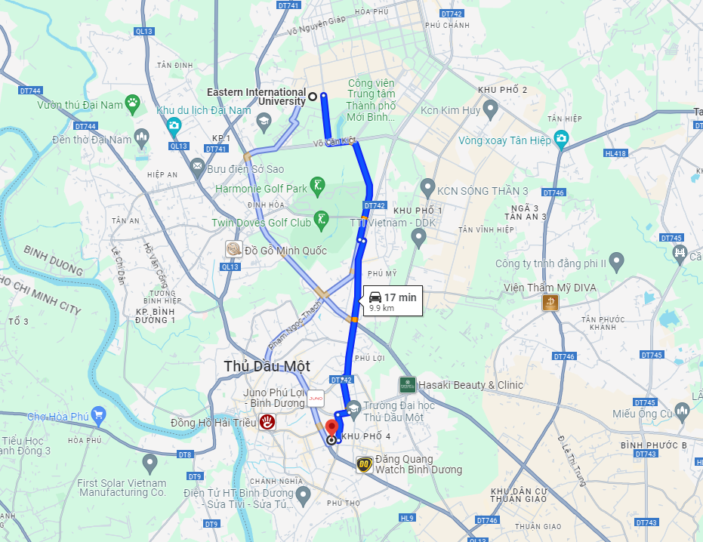

Slide 13
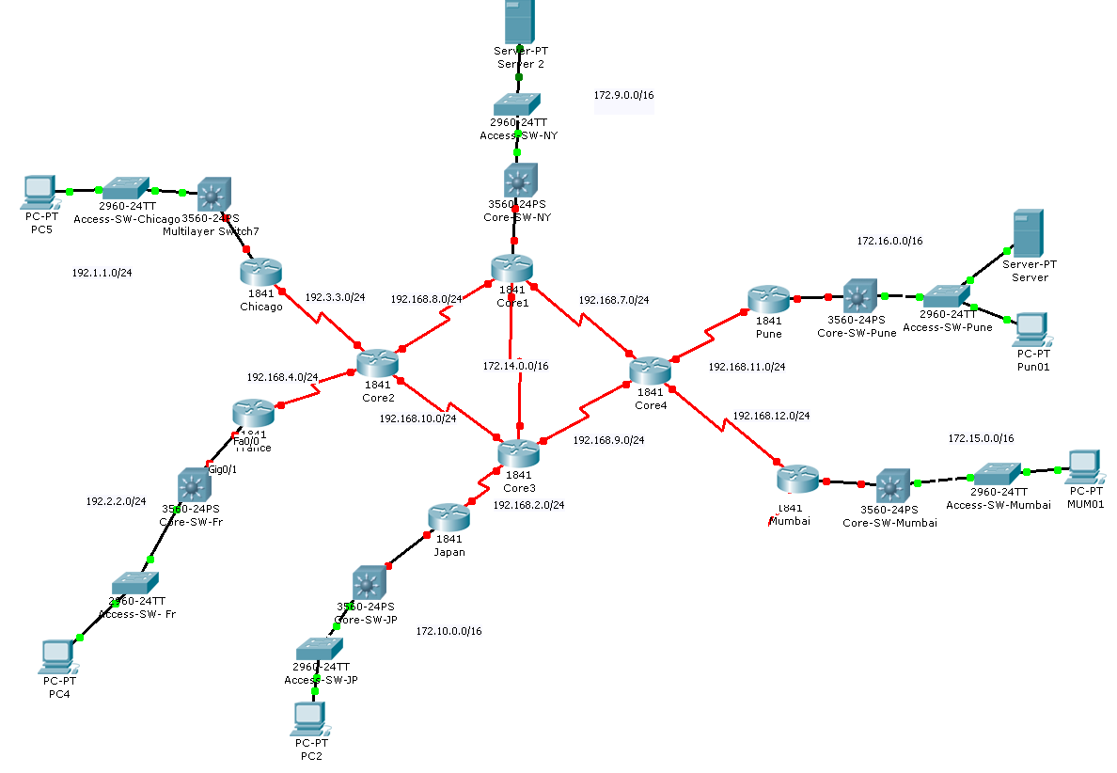

Slide 14
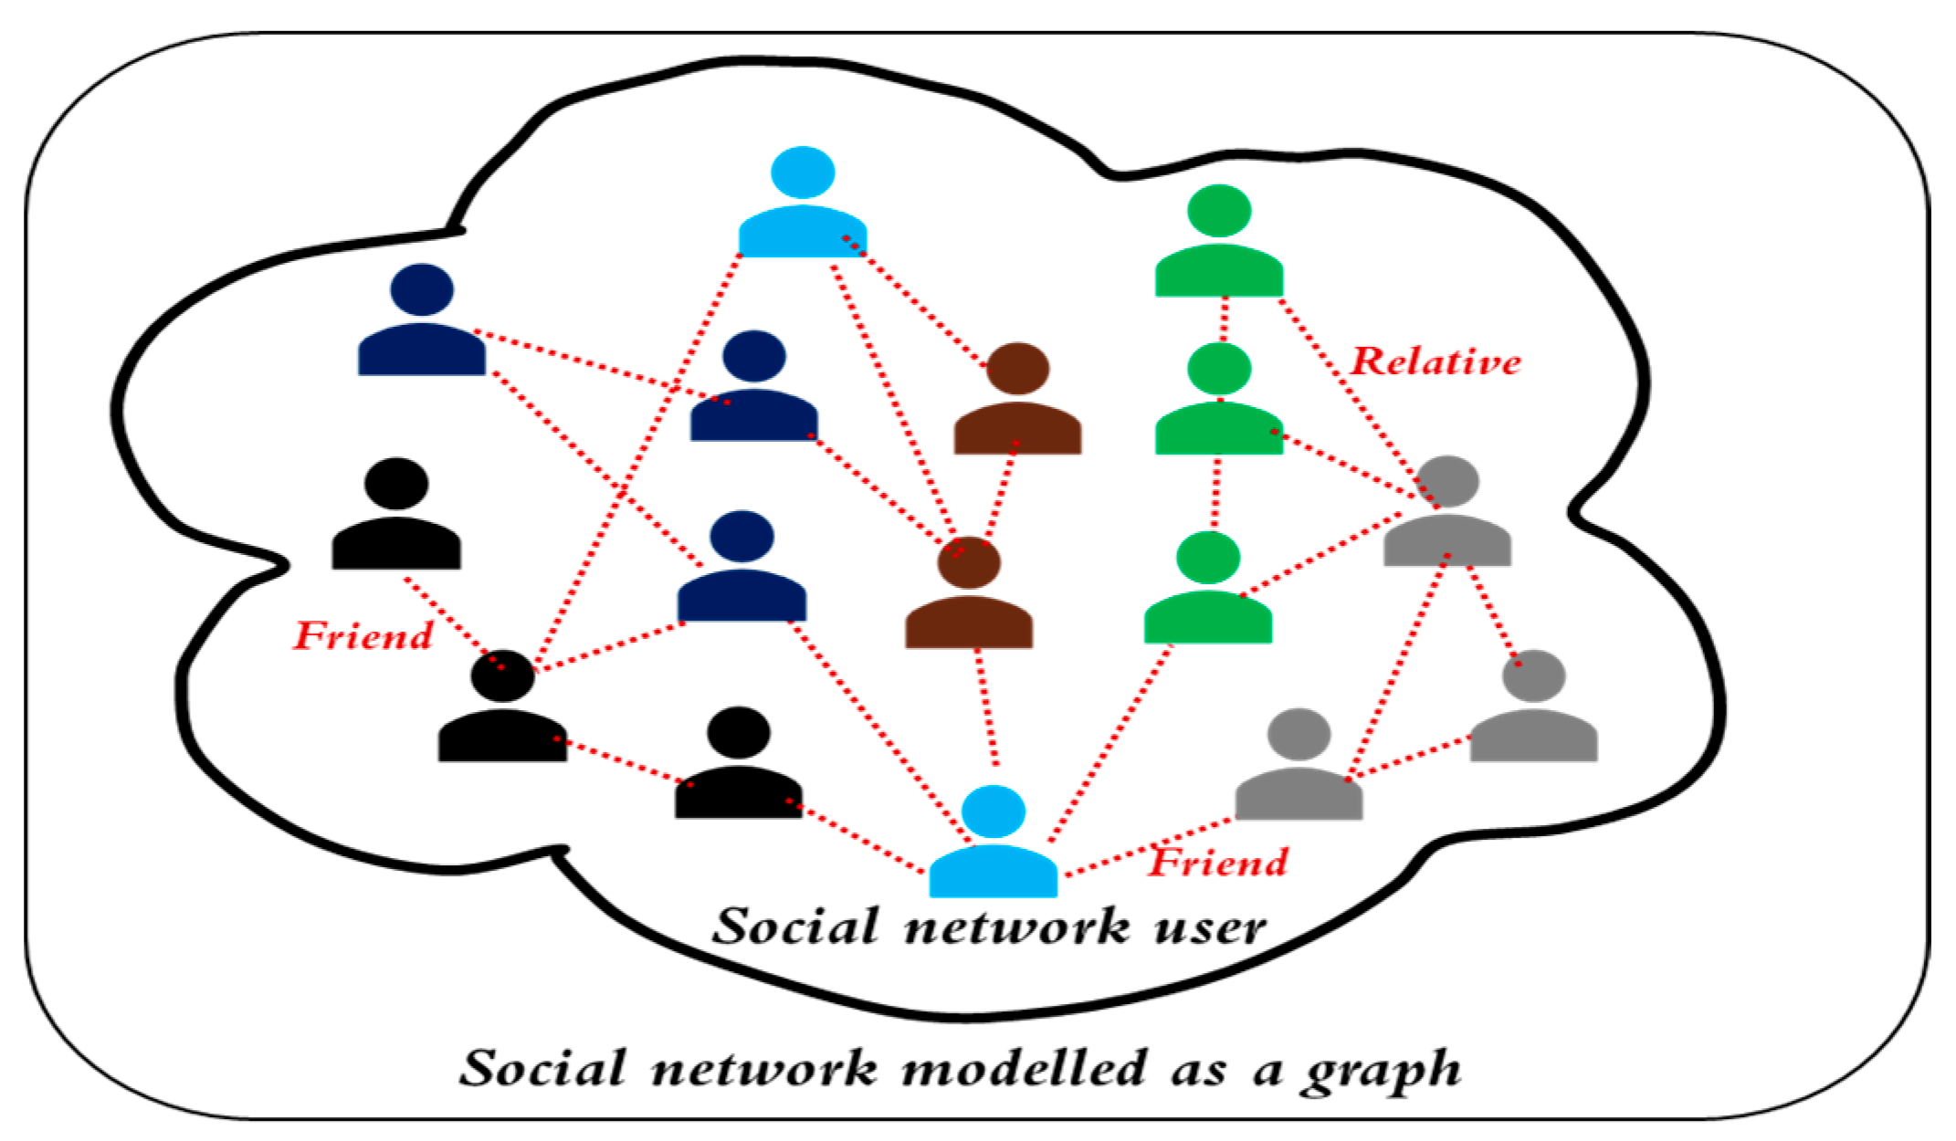
Social Network

Slide 15
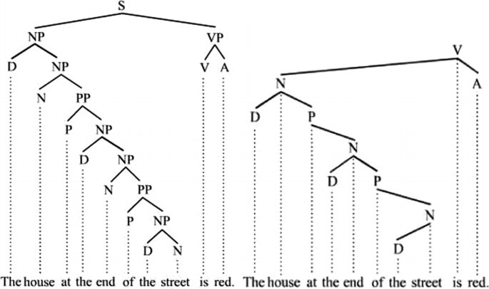
Linguistics

Slide 16
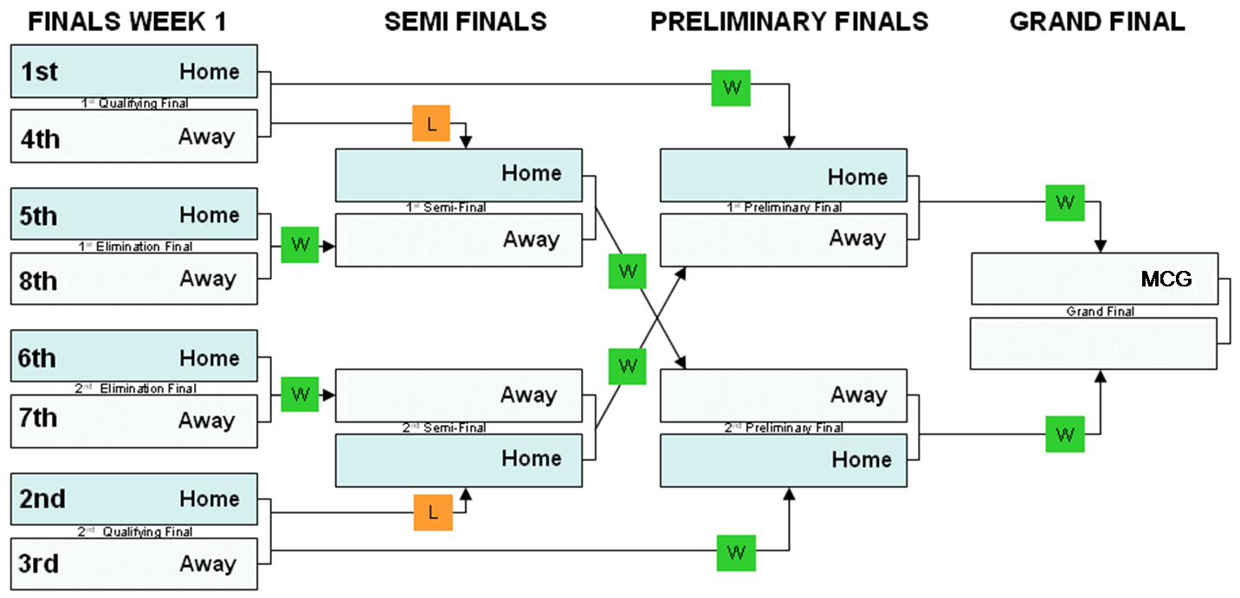

Slide 17
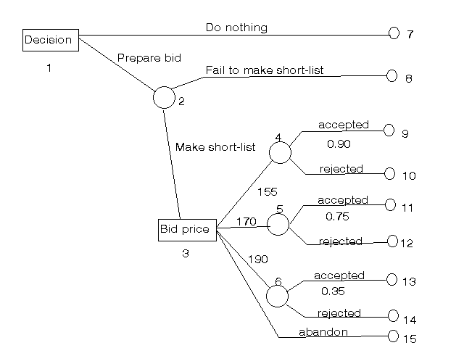

Slide 18
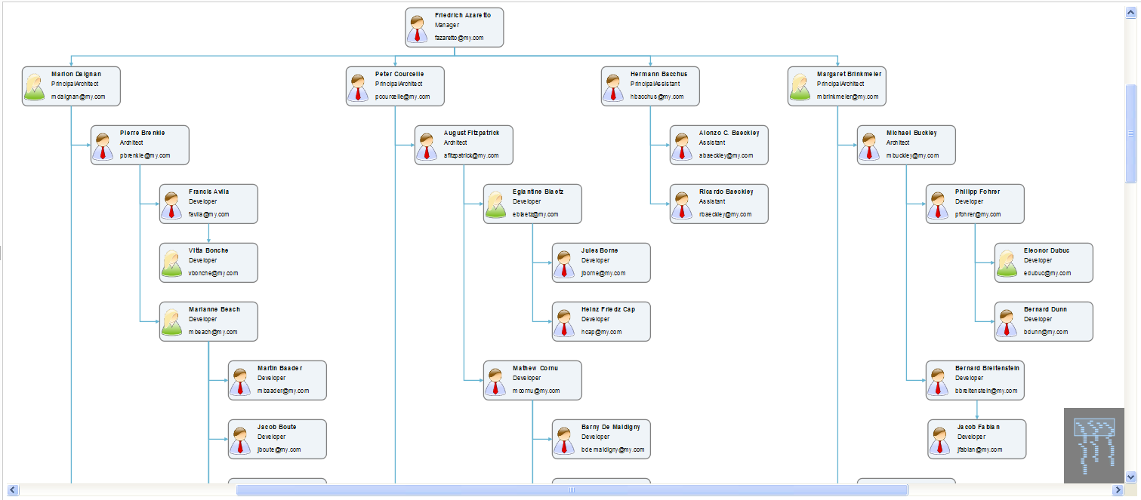

Slide 19
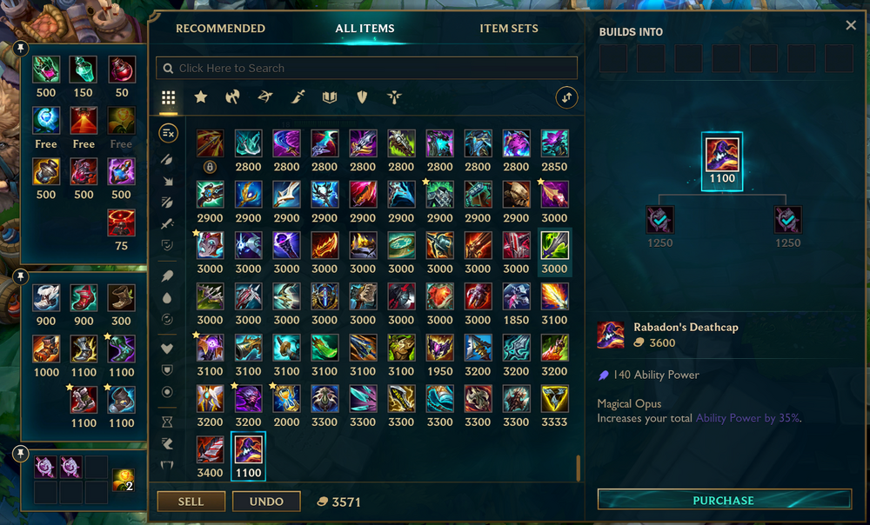
Applications in game

Slide 20
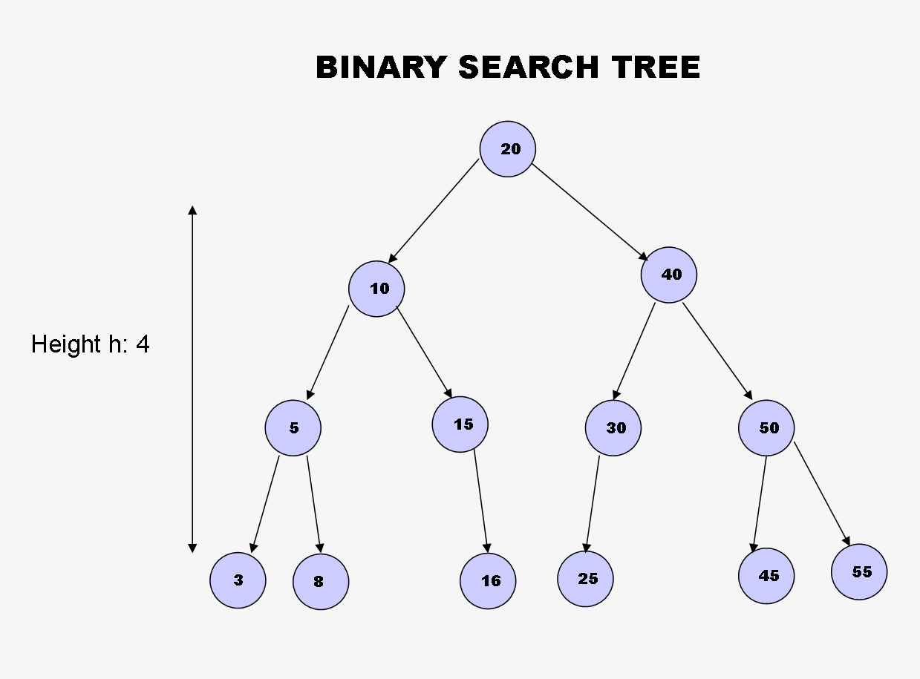

Slide 21
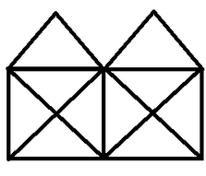
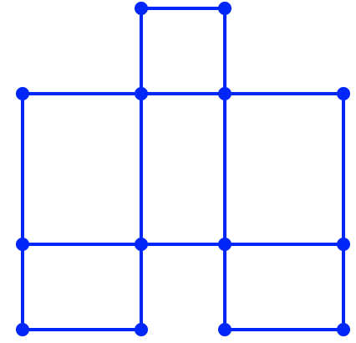
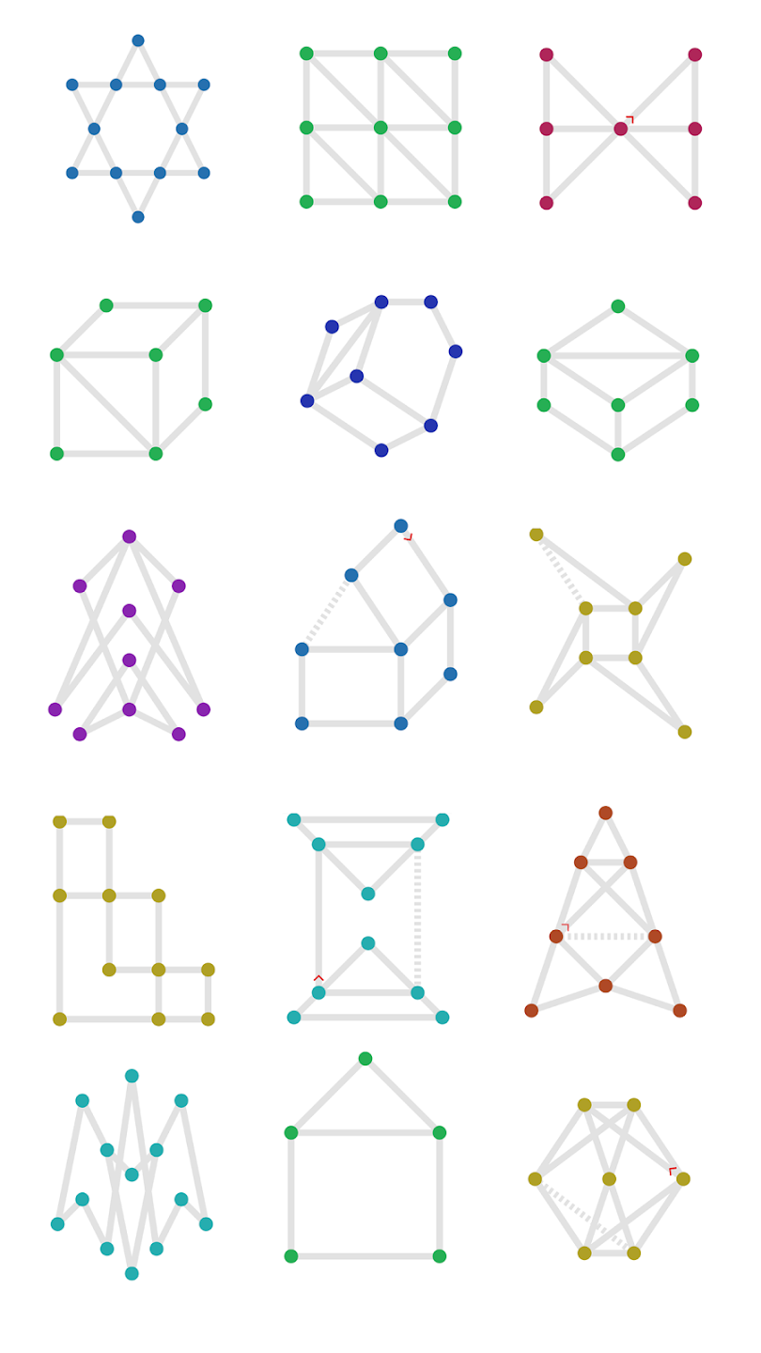
Drawing something using one pen stroke

Slide 22
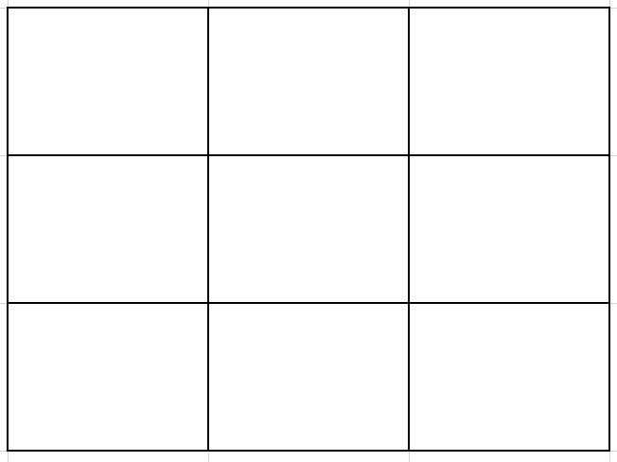
Game
Draw the grid again in one stroke to minimize the number of segments, including counting overlapping segments

Slide 23

Discrete Mathematics II
Lecturer
  Lecturer: Nguyễn Manh Phúc
  Email: phuc.nguyenmanh@eiu.edu.vn
  Zalo:

Slide 24
Discrete Math 2
Text books
  Kenneth H. Rosen, Discrete Mathematics and Its Applications, 8E
  Reinhard Diestel, Graph Theory, 6th Edition (2024), Springer-Verlag Heidelberg.
Slides
  Moodle.
References
  http://visualgo.net/

Slide 25
Learning Outcomes
After successful completion of this course, students are able to:
Create model for a practical problem in Graph language
Design algorithms, prove the correctness of the algorithms
Represent Graph problem in data structures and programming languages.
Apply graph algorithms and related data structures to solve specific graph problems

Slide 26
DISCRETE MATHEMATICS II
Graphs
Trees
Applications

Slide 27
Contents
Graphs
  Graphs and Graph Models
  Graph Terminology and Special Types of Graphs
  Representing Graphs
  Graph Isomorphism
  Graphs Traversal
  Connectivity
  Applications of Graphs
  Euler and Hamilton Paths
  Shortest-Path Problems
  Network flows
  Planar Graphs

Slide 28
Contents
Tree
  Introduction to Trees
  Applications of Trees
  Tree Traversal
  Spanning Trees
  Minimum Spanning Trees
  Binary Tree
  Balanced Tree
  Binary Search Tree

Slide 29
Schedule
Theory: Mon, Wed (16:30 – 18:30)
Practice: Thu (10:30 - 13:30)
Attendance check: any time

Slide 30
Programming Languages
Prefer: Java, C#

Slide 31
Assessment
Labs (SPOJ): 20%
  Submission after Jun 30(16:30 GMT+7).
Tests: 40%
  2 practice tests
  1-2 theory tests (offline or online, TBD)
Final Exam: 40%

Slide 32
Labs
SPOJ
  Username: ei254[First name][Partial last name][1-9] (Maximum 14 characters) or any ei… accounts
  Display name: student’s full name
  Fill in Google Sheet:

Slide 33
FAQ
How many hours should student spend for this course per week?
  Lectures: 4 hrs.
  Labs: 3hrs.
  Self-study: at least 9.5 hrs
Is it difficult to pass this course?
  Yes, It can be challenging.
  But with regular study and independent practice, you can definitely pass.
  Otherwise, you risk failing the course.

Slide 34
CHEATING
Students will receive a zero on an assignment if any of these activities take place:
accepts an assignment from another student
supplies an assignment to another student
posts the assignment on the web, social networking site
shares their password with another student tot access to their assignments
work together on assignments and turn in the same and/or similar assignments.
turns in work that was obtained from other sources such as the web, friends…
leaves work available for others to copy from

Slide 35
Notes
Lectures: Full-charged Laptop
Turn on camera during online sessions

